Slide 1
Timber Construction in Finland
and normative developments
Tomi Toratti
Federation of the Finnish Woodworking Industries

Slide 2
Content of the presentation
Introduction
Timber industry
Urban construction with Timber
Recent developments in Timber Engineering
Normative Development in Europe – standards
Fire regulations
Challenges and conclusions

Slide 3



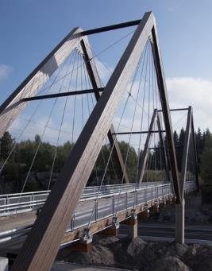
Gross value of production
Finnish wood working industry in numbers
Export value
6,5 Mrd
2,5 Mrd
Labour
Raw material use
26 000
26 Mm³

Slide 4
Finnish Woodworking Industries 2017
600+ companies with one voice
Finnish Forest Industry Federation
Log house industry (17)
Federation of the Finnish Woodworking Industries
Stora Enso
Wood Products
Stair case producers (8)
Metsä Wood
Joinery industry (40)
Metsä Fibre
Wood preserving industry (16)
Versowood
Thermowood association (17)
UPM Plywood
Association of Finnish woodworking and furniture industries (500)
UPM Timber
WoodInfo

Slide 5
Product based lobbying
Four main areas
Removal of regulations against the use of wood and increase of demand
European lobby work
Increase of knowledge
Strengthening the competitiveness of wood products
Norms and regulation
Education
European cooperation
Research and development
Public procurement
Construction regulation
Research focus
Industry needs
Resources in education
Nordic cooperation
fire
energy efficiency
European cooperation CEI-Bois
Balance of the demand and supply
Program coordination
Content of education
LCA, footprint
Resource efficiency
Environment
Material development
End-use
Continuous collapse
Standardization

Slide 6
The growth of Finnish forests is over 100 mill. m³ per year
FOREST BALANCE IN FINLAND 1960-2011

Slide 7
The biggest new potential is where decisions are made professionally and where the buildings are big
Market share of wood in frames %
Market share of wood in facades %
Total potential (1000m3)
Blocs of flats
Public and comm.
Other...
Semi-det. houses
Agriculture
Detached houses
Industry and ware.
Source: Tilastokeskus, Rakentamisen tilastot. VTT

Slide 8
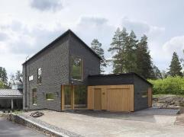
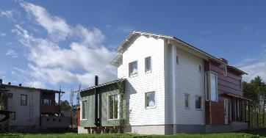
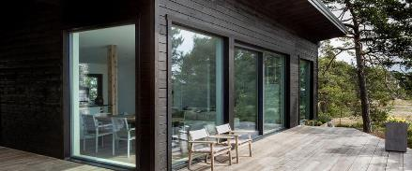
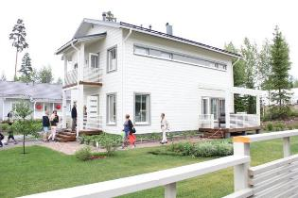
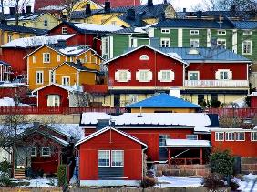
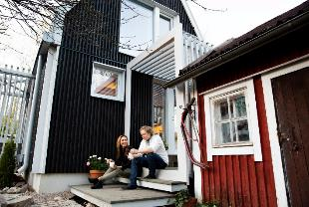
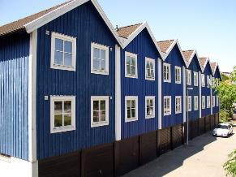
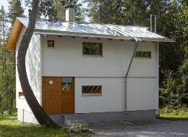
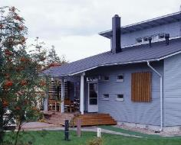
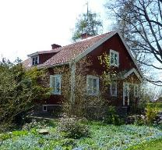
Over 80 % of the single family homes in Finland are wood based

Slide 9
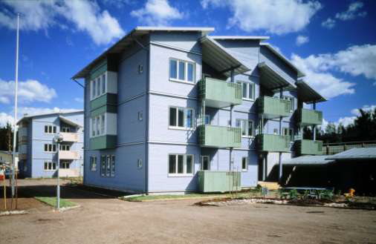
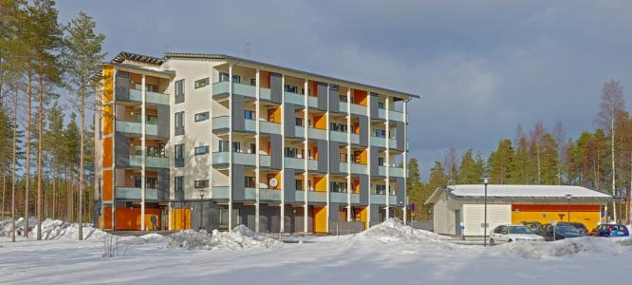
Multi-storey Wood construction in Finland
First modern multistorey timber
buildings in 1996, max 4 storeys,
from 2011 up to 8 storeys possible
81 multi-storey houses
2100 apartments (2018)
51 multi-storey houses under
planning or construction

Slide 10
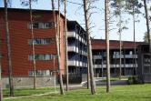
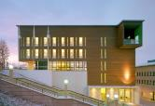
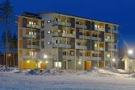
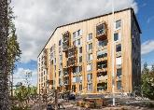
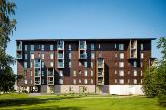
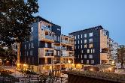
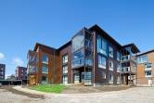
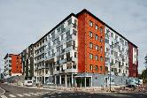
The construction of wooden block of flats is growing
Lähde: Tilastokeskus, Forecon
Main reasons for good development
2011 and 2018 new fire regulations relaxed the use of wood
Municipalities have been very actively looking for new options to build houses
New type of industrialised building systems and their potential

Slide 11
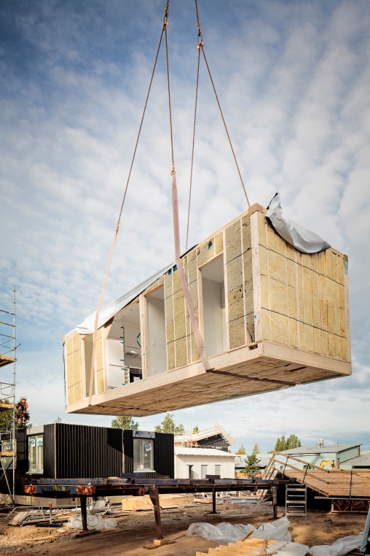
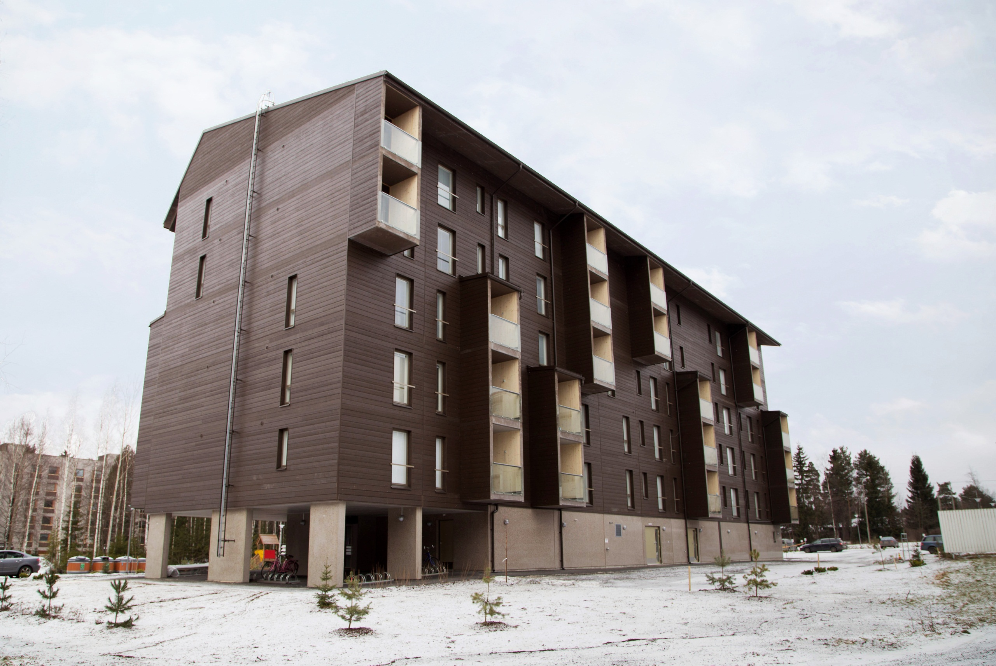
Photos: Stora Enso

Slide 12
Wood in urban construction is gaining popularity

Slide 13
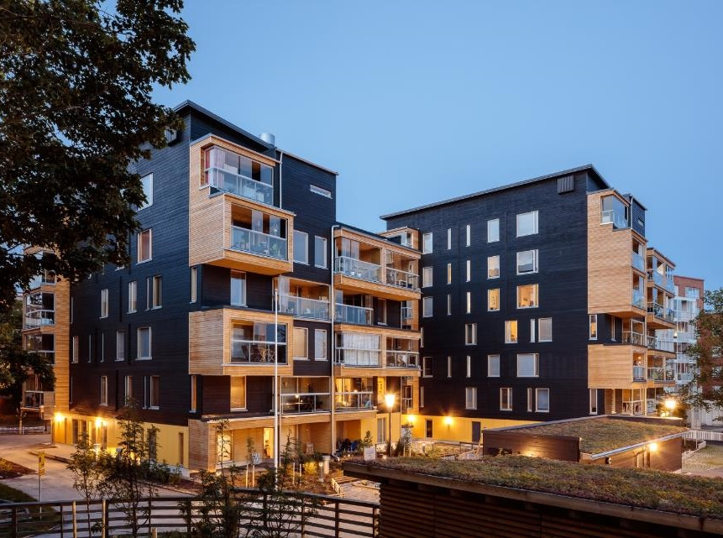
Eskolantie, Helsinki

Slide 14
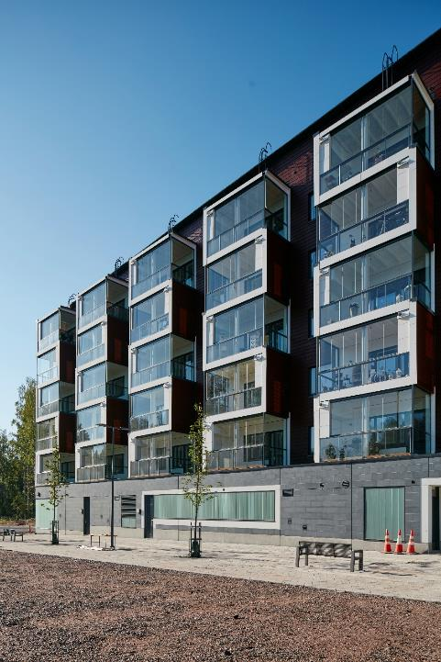
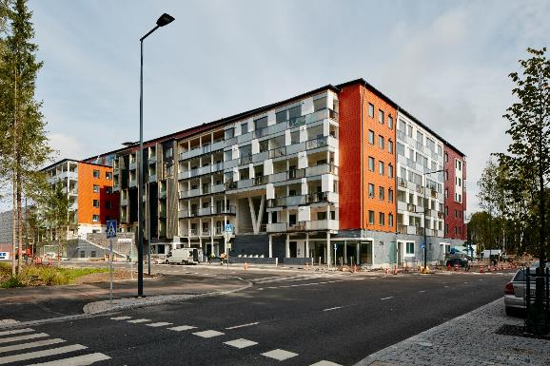
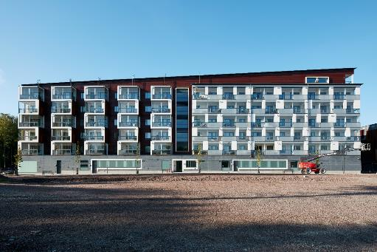
Kivistö, Vantaa

Slide 15
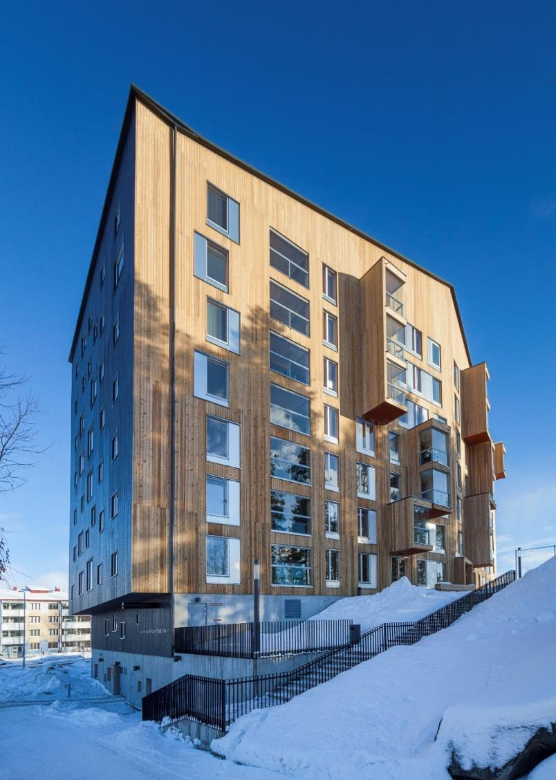
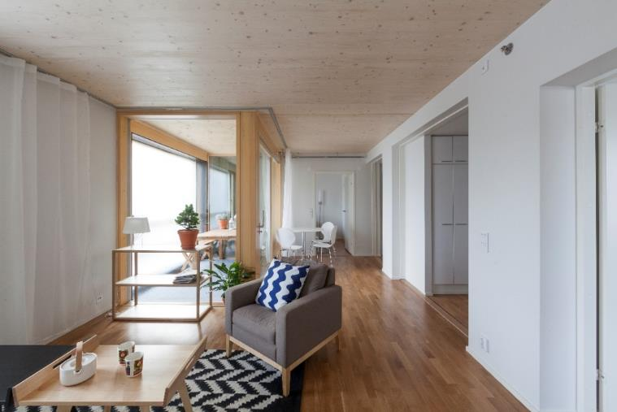
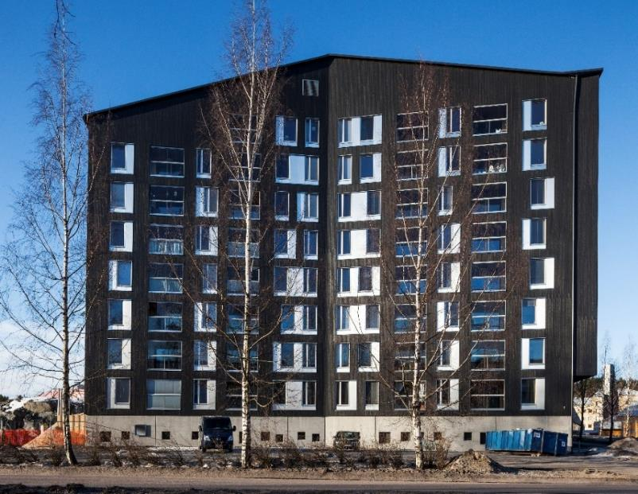
Puukuokka, Jyväskylä

Slide 16
The question today is
“How to use wood” in new end-uses and urban surroundings?

Slide 17
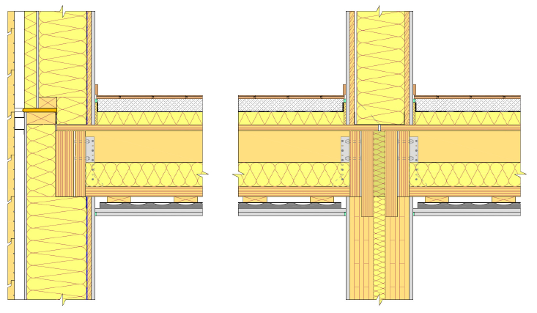
Runko PES
Timber element standard

Slide 18
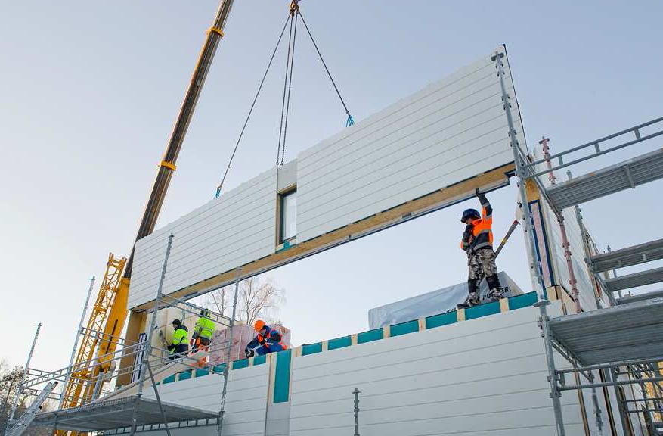

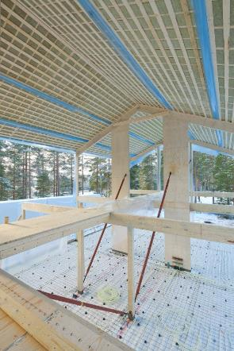
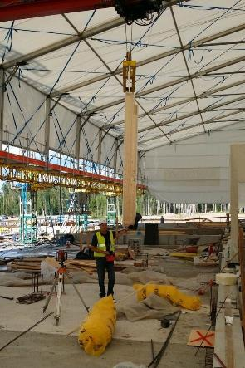
The new industrial building methods
Large elements
Volume elements
Post and beam
Hybrid technology

Slide 19
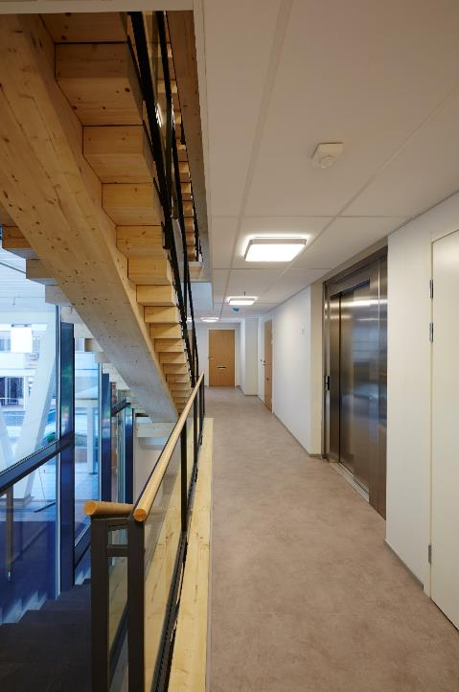
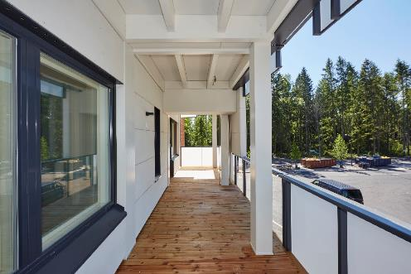
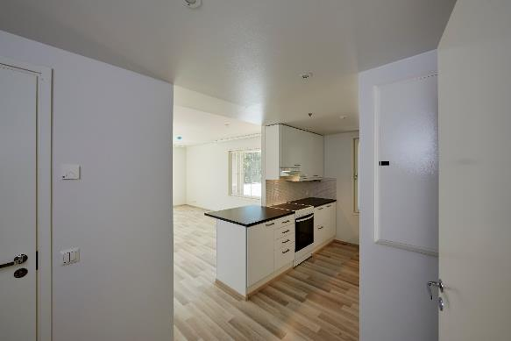

Slide 20
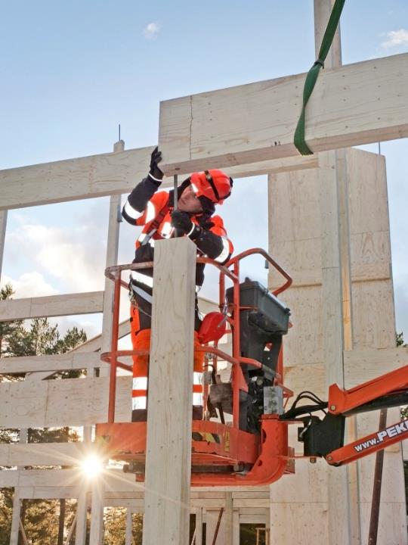
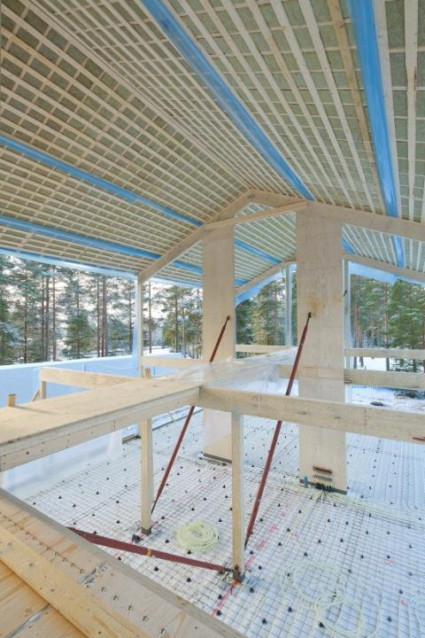
Post and beam
Photos: Metsä Wood

Slide 21
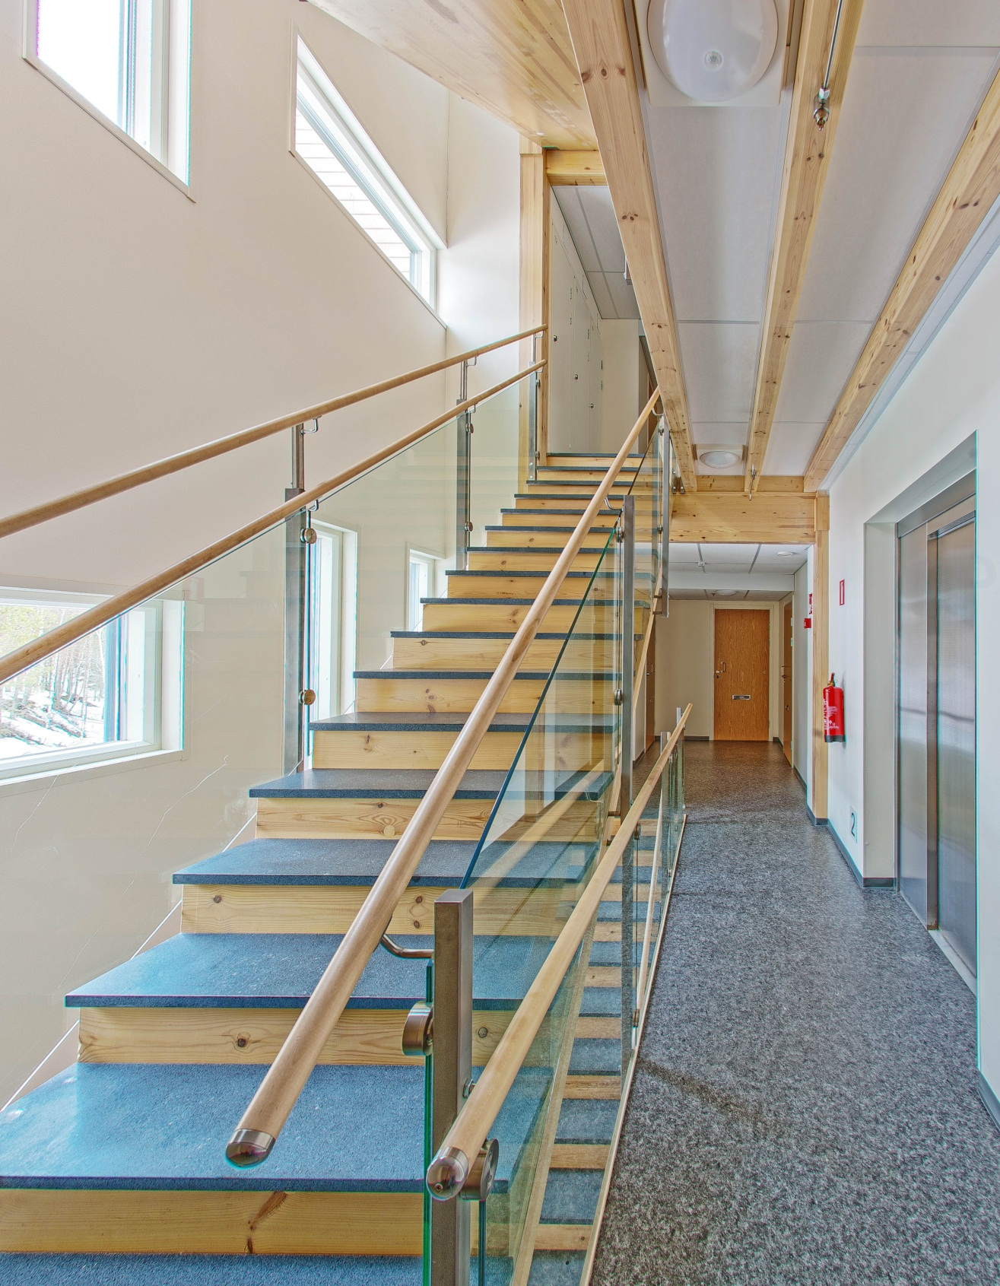
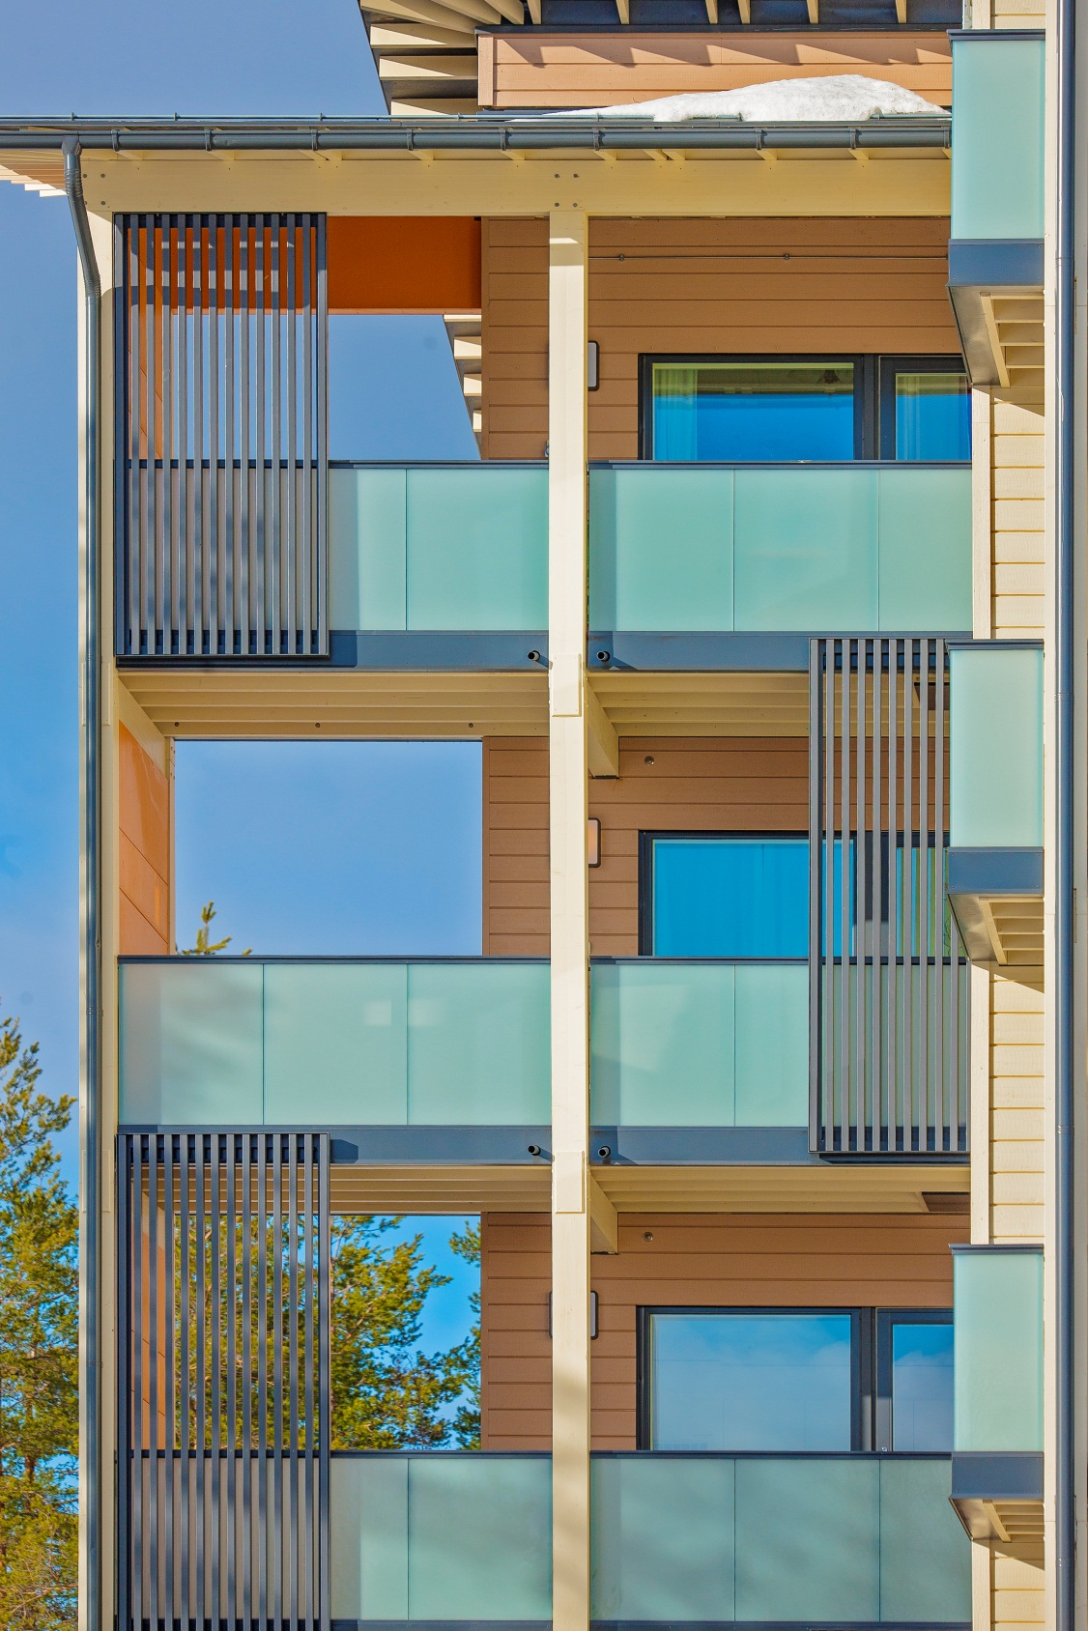

Slide 22
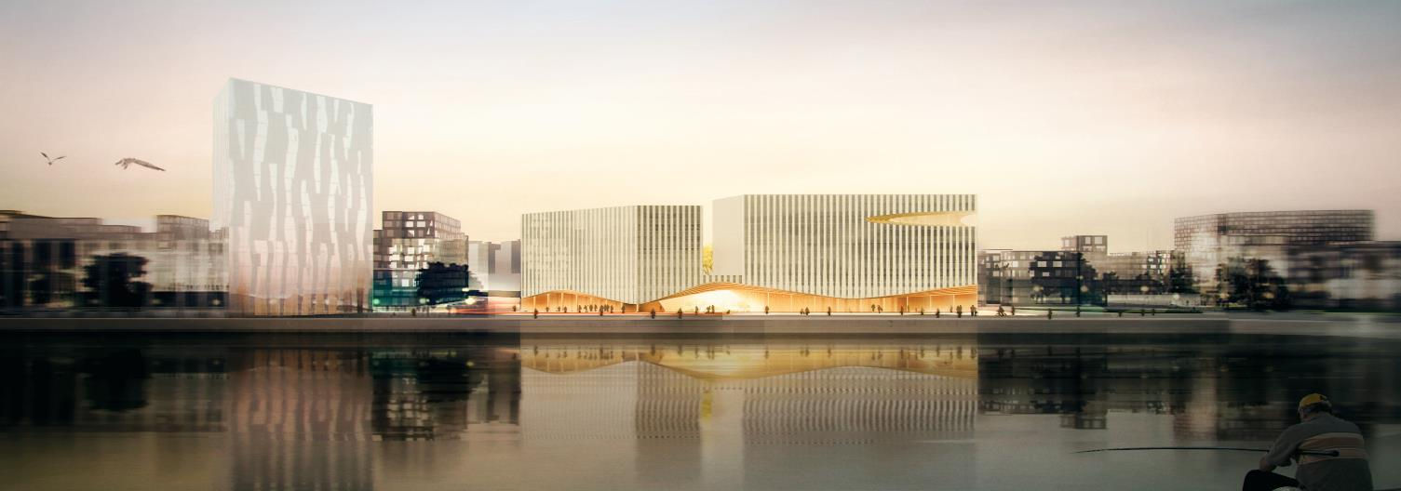
Case Wood City
Notes:
Lets then look at another project in Helsinki city center.

Slide 23
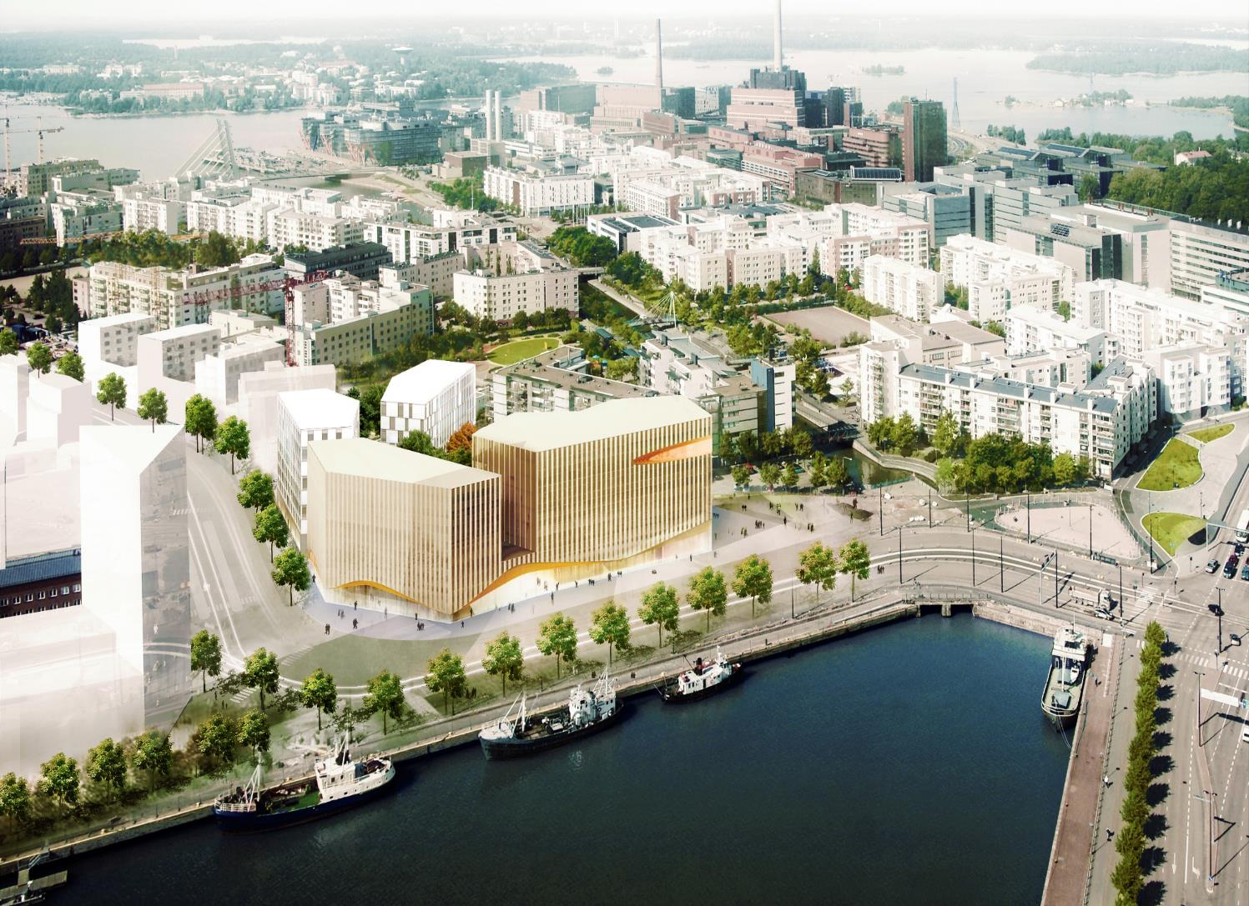
Wood City
Office building
12 000 m²
Three different types of building systems:
  Apartments: large panel LVL
  Hotel: pre-fab CLT room modules
  Office: gluelam beams and columns, CLT slabs and LVL panel walls
Ground floor, staircases and elevator shafts in concrete
LEED Gold as minimum target
98 apartments
8 000 m²
180 hotel rooms,
7 000 m²
Notes:
The project comprises three main blocks to be build with three different type of wooden building systems:
98 apartments in two blocks to be build with LVL system
180 rooms hotel to be build with ready-made room modules
12.000 sqm office building, 170 parking spaces
We are targeting minimum LEED gold ceriticate.

Slide 24

Expectations of Users
and Tenants
Location remains the key selection criteria
Potential risks (fire, noise, humidity control etc.) must be covered with references and tests
Environmental values increasingly important
Wood can strengthen the brand image

Slide 25
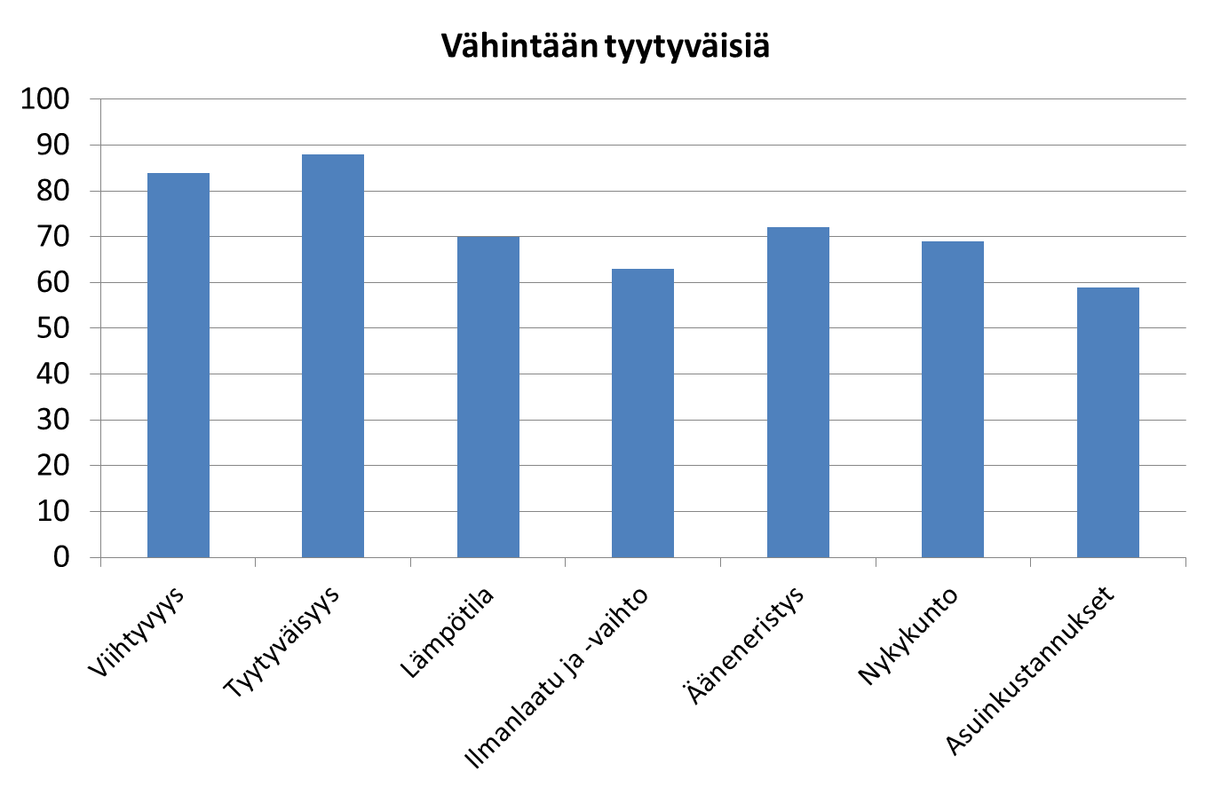
Customer opinion
FWR/TTY survey 2011:
6 buildings from 1996 – 2003
Flats 157 (24 % of all)
118 answers (75 %)
    Owners 58%
    Rentals 42%
Satisfaction rate %
Comfort
Overall satisfaction
Ventilation
Sound insulation
Present condition
Living costs
Temperature

Slide 26
Schools, kindergardens and elderly centers have also started to use more and more wood
Log building

Slide 27
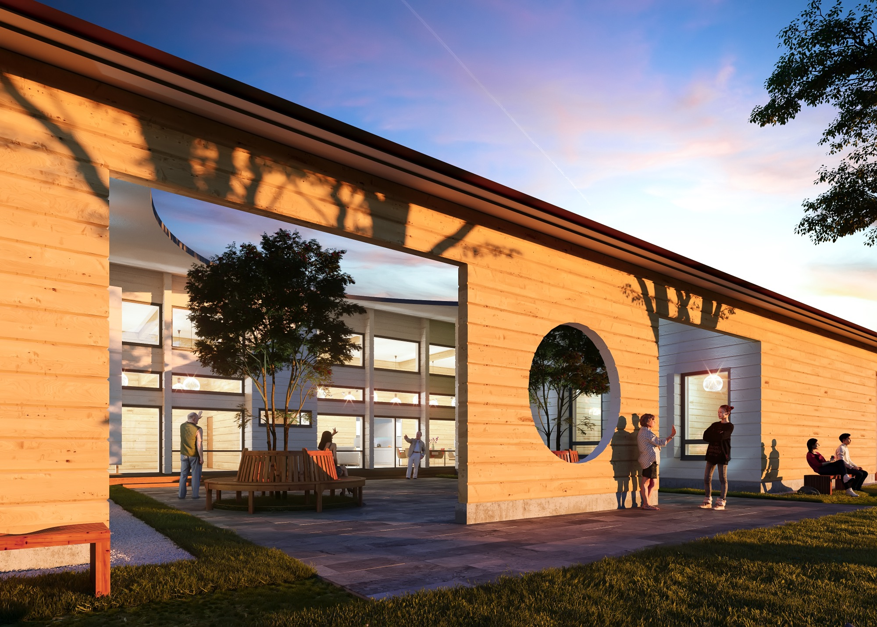

Slide 28
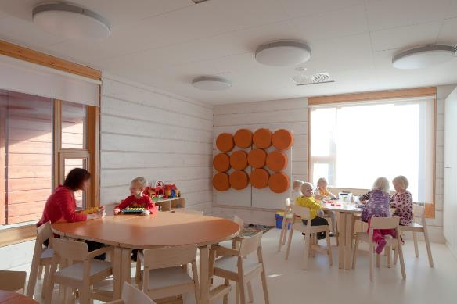
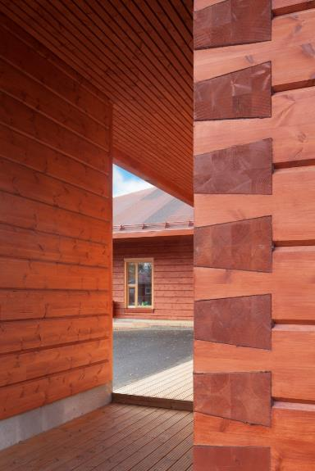
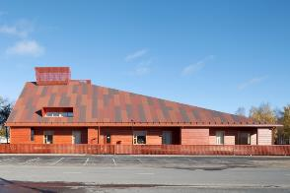
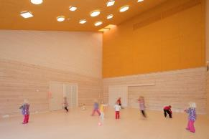
Architect Janne Pihlajaniemi, Arkkitehdit M3

Slide 29
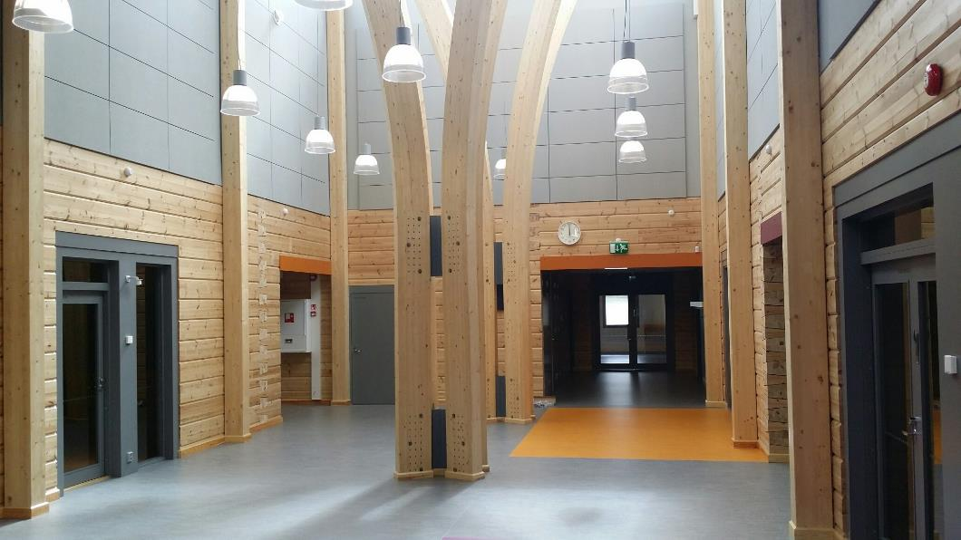
Arkkitehtitoimisto Lukkaroinen Oy
Photos: Kontio

Slide 30






Kindergarten Haapaavesi 2013
1 200 m²

Slide 31
Technical challenges in Building with Wood

Slide 32
Challenges in Building with Wood
Challenge | Description
Lack of professionals in the field | Needs for Wood engineering education
Wood as an engineering material | General know-how on: Proof on service life Material variability and structural reliability Effects of moisture Exploitation of architectural possibilities
Technical issues | Design for durability Vibration of floors Fire regulations Connection design Bracing of structures
Regulations, Standards and CE-marking, Eurocodes | Needs participation in standardization

Slide 33
Normative development

Slide 34
The Standard chain
- setting the quality level
Product Standards
- material properties
- intended use
- material quality
control
- production
tolerances
- Material moisture
Content
- CE-marking leads
to acceptance in EU
Design standards
- Eurocodes
- design equations
- safety factors
- model
assumptions
- ease of use
Execution standards
- follow the design
- workmanship
(air tightness,
acoustic gaps)
- assembly tolerances
- moisture protection
- on site quality control

Slide 35
CE marking of Wood Products
Harmonised standards for wood products
EN 13986 Wood-based panels for use in construction
EN 14250 Prefabricated structural members assembled with punched metal plate fasteners
EN 14374 Laminated veneer lumber
EN 14342 Wood flooring
EN 14080 Glued laminated timber and glued solid timber
EN 14081 Strength graded structural timber
EN 14915 Solid wood panelling and cladding
EN 14545 Connectors
EN 14592 Dowel-type fasteners
EN 14229 Wood poles
EN 15497 Structural finger jointed solid timber
To be finalised
EN 16351 Cross laminated timber
EN 14732 Prefabricated, structural wall, floor and roof elements

Slide 36

Open Industrial standard

Slide 37
Eurocode 5 Design of timber structures
- EN 1995-1-1 Common rules and rules for buildings
- EN 1995-1-2 Structural fire design
- EN 1995-2 Bridges
- National annexes are ready and these are being compared
- Eurocodes have been in use for several years

Slide 38


Eurocode 5 Design of timber structures
New generation of the Eurocodes is under work in CEN/TC250/SC5 by 2022
Simplification of the design work
Bring in new research results
New design rules for:
- Cross laminated timber CLT
- Reinforcements and holes in beams
- Timber concrete composite structures
- New approaches to connections, stability and floor vibrations

Slide 39
Fire regulations in Europe

Slide 40
Block of flats up to 8 floors
P2 fire class maximum 8 storeys with REI 60 structures
Sprinkler system is required
K₂10 (4 floors) or K₂30 (5-8) fire protected structures
A-class insulation materials
Special requirements for eaves, wooden facades (flame traps), emergency exits, balconies
D-s2, d0
B-s2, d0
1997
2011

Slide 42


Slide 43


Slide 44


Slide 45



















Fast, Light and Green
Notes:
WOOD CONSTRUCTION
Previous program was successful.
Block of flats
Public buildings due to the indoor air quality
Log Houses
Bridges
Renovation and retrofitting

Slide 46

6H₂O + 6CO₂ → C₆H₁₂O₆ ₊ 6O₂

Slide 47




Other potential areas to use more wood
Renovation of thje old block of flats
Public buildings
Big structures and halls
Bridges

Slide 48
Where to get information ?

Slide 49


Slide 50


Slide 51

About 300 registrants expected

Slide 52

World Conference on timber engineering
Santiago de Chile, 24 – 27 August 2020
About 800 registrants expected

Slide 53







Спасибо !

